Slide 1

GROUP 4
Võ Thanh Duy
Nguyễn Xuân Tuệ
Nguyễn Phước Duy
Nguyễn Minh Trung Hiếu

Slide 2
I. What is Cypress?
II. Advantages and Disadvantages.
III. Installing Cypress
IV. Demo

Slide 3
What is Cypress?
Cypress is a automation test tool.
Open-source.
Built for modern Web.
Supported language: Javascript.
Cypress supports:
Set up tests: simple & no need install enviroment.
Write tests: easily to write, read, and understand.
Run tests: run any time.
Debug Tests: readable error messages help you to debug quickly.
End-to-end tests
Unit tests
Integration tests
Types of test:

Slide 4
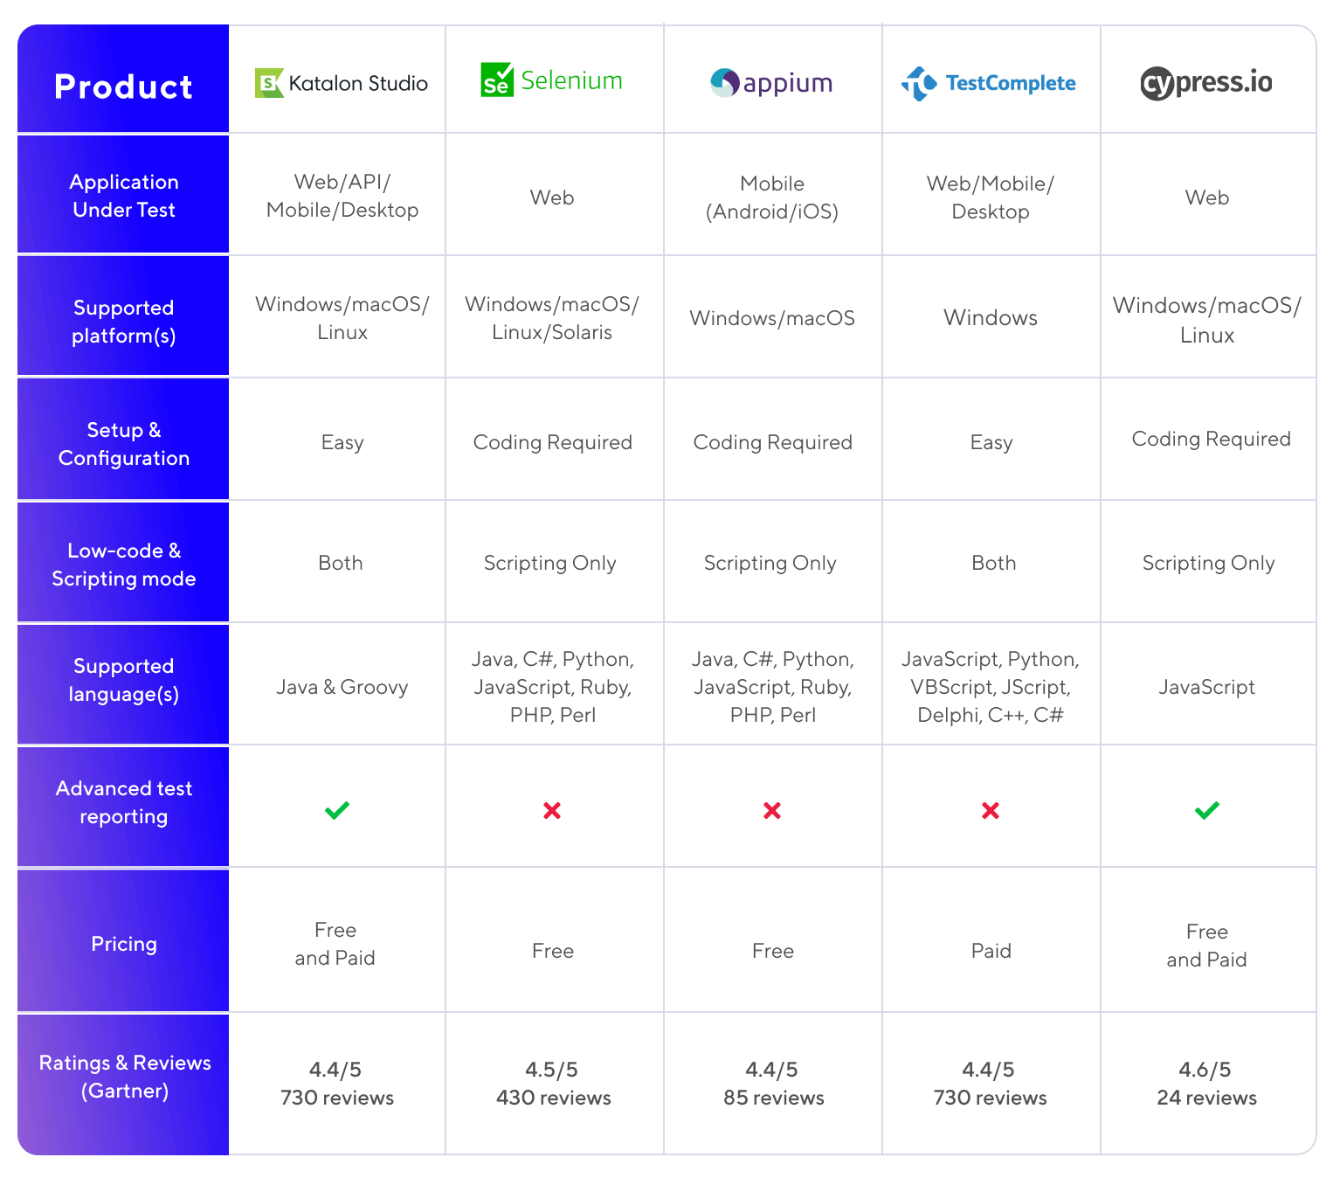
copy from https://anhtester.com/blog/15-cong-cu-kiem-tra-tu-dong-hoa-hang-dau-nam-2022-cap-nhat-moi-nhat-b443.html

Slide 5
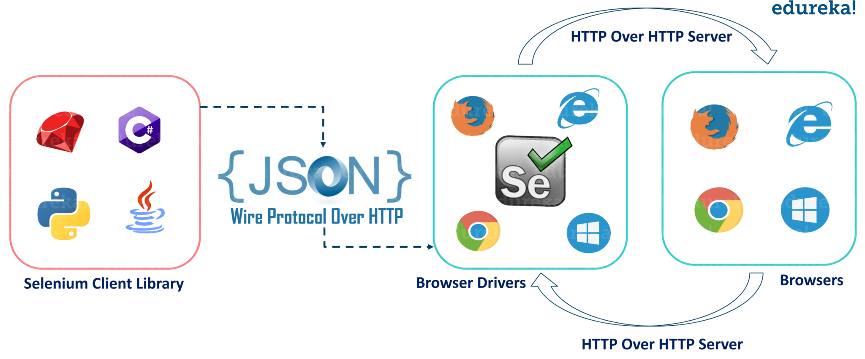
What is the difference between Selenium and Cypress?
1. ARCHITECTURE
Selenium
copy from https://github.com/cypress-io/cypress-documentation/issues/872

Slide 6
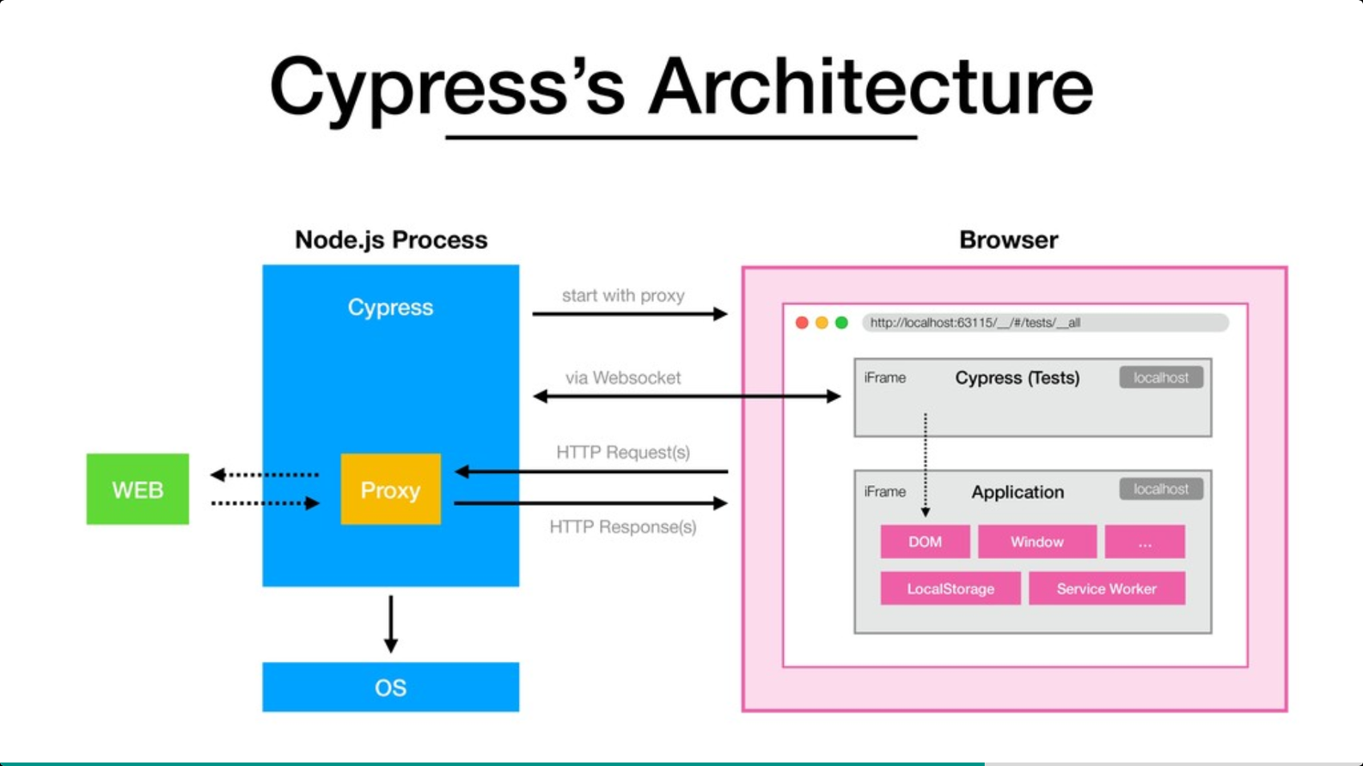
b. Cypress
copy from https://github.com/cypress-io/cypress-documentation/issues/872

Slide 7
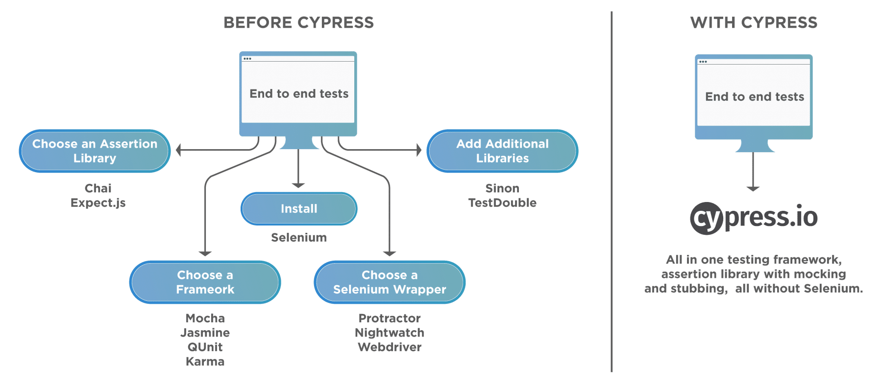
-copy from https://www.toolsqa.com/cypress/wha-tis-cypress/

Slide 8
 | Cypress | Selenium
Languages Supported | JavaScript Only | Supports all popular languages like Java, Python, Ruby, C#, Php, etc.
Browsers Supported | Chrome, Edge, Firefox(beta), Electron | Chrome, IE, Safari, Edge, Firefox, Opera
Frameworks Supported | Supports only Mocha JS | Supports multiple frameworks based on specific programming languages. (For e.g: JUnit for Java, Cucumber for JavaScript, etc.)
Setup Complexity | Setup is simple. No dependencies or additional downloads required | Setup is a bit challenging as it requires downloading browser-specific drivers and setting up the test environment
Documentation & Community Support | Very intuitive documentation along with rapidly growing community | Well established documentation and firm community support from users across the globe

Slide 9
II. Advantages and Disadvantages
Advantages:
Open source.
Simple, easy to install and write test scripts.
The documentation is complete, detailed.
Debugging is easy because of the support to take pictures of errors and recorded actions during test script running.
Provide a Dashboard service page where you can view an overview and report the results after each run.

Slide 10
Disadvantages:
Cypress does not support to test a native app.
Interaction with multiple tabs cannot be supported due to running inside the browser.
Cypress does not support multiple browser instances or control more than one open browser simultaneously.
Only Javascript is supported.
It does not support remote execution.

Slide 11
III. Installing cypress
Cypress is a desktop application that is installed on your computer. The desktop application supports these operating systems:
Operating System
macOS 10.9 and above (64-bit only)
Linux Ubuntu 12.04 and above, Fedora 21 and Debian 8 (64-bit only)
Windows 7 and above (64-bit only)

Slide 12
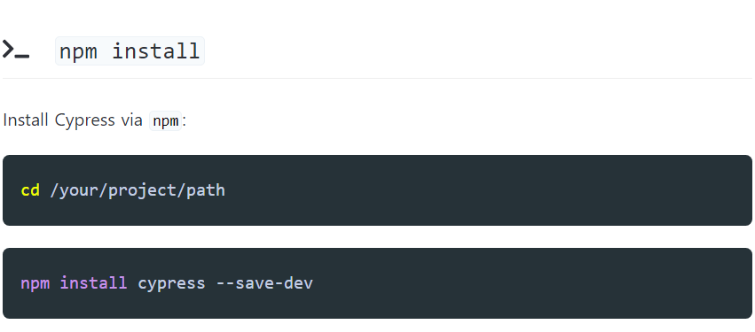
III. Installing cypress

Slide 13
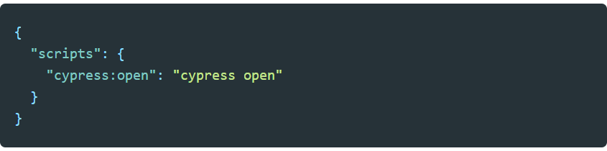
III. Installing cypress
Add Cypress commands to the scripts field in your package.json file.

Slide 14

III. Installing cypress
Now you can invoke the command from your project root like so:

Slide 15
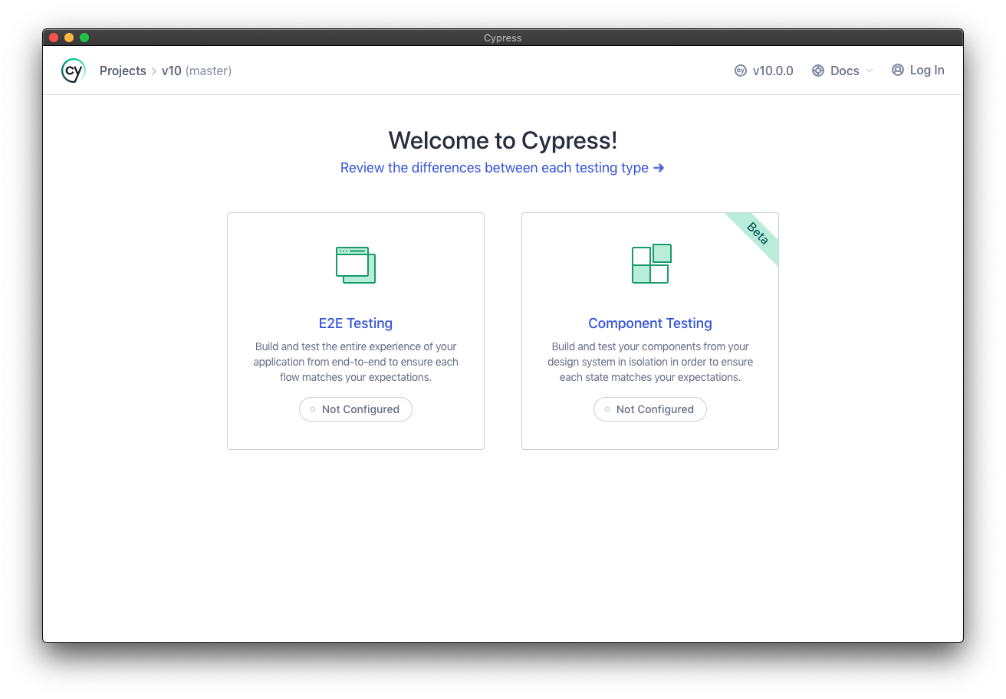
III. Installing cypress
The Launchpad:

Slide 16
IV. Demo
…

Slide 17
Thanks for watching!

